Slide 1
High Performance Computing Lecture 11

Slide 2
Parallel Computing
Parallel Architecture
Introduction to Parallel Programming

Slide 3
Parallel Architecture
Parallel computer: A computer system with more than one processor
CPU
1
CPU2
ALU |  | Registers
 | Control
ALU
Registers
Control
Memory
MMU
Cache
MMU
Cache
Bus
I/O
I/O
I/O

Slide 4
Parallel Architecture
Question: Is a network of computers a parallel computer?
Yes, but the time involved in interaction (communication) might be high, as the system is designed assuming that the machines are more or less independent
Special parallel machines would be designed to make this interaction overhead less

Slide 5
Parallel Architecture
Parallel computer: A computer system with more than one processor
Question: Why use parallel computers?
  With two processors, twice as many instructions can be executed in a given amount of time
    i.e., improved performance, reduced program execution time
  The computer can continue to operate even if one of the processors fails
    i.e., fault tolerance

Slide 6
Classification of Parallel Computers
Flynn’s Classification
In terms of the number of Instruction streams and Data streams
Instruction stream: A path to instruction memory (i.e., a program counter or PC)
Data stream: A path to data memory
  SISD: single instruction stream single data stream
  SIMD: single instruction stream multiple data streams
  MIMD: multiple instruction stream multiple data streams

Slide 7




Flynn’s Classification: SISD
Single Instruction Stream Single Data Stream
  i.e., one program counter and one path to data memory
  i.e., a computer capable of executing one instruction at a time operating on one piece of data
  i.e., an ordinary (sequential) computer
CPU
ALU
Registers
Control
Memory
MMU
Cache
Bus
I/O
I/O
I/O
8

Slide 8
Flynn’s Classification: SIMD
Single Instruction Stream Multiple Data Streams
  i.e., one program counter, multiple paths to data memory
  i.e., a computer capable of executing one instruction at a time, but operating on different pieces of data

Slide 9
Flynn’s Classification: SIMD
Example: A computer with 1024 ALUs (each with a separate data path to memory), but only one program counter (PC and IR)
The same MUL instruction is executed on each of the
ALU
ALUs, but on different pieces of data
PC
IR
MUL A_{i}, B_{i}
ALU
…
ALU

Slide 10
Flynn’s Classification: MIMD
Multiple Instruction Stream Multiple Data Stream
  i.e., a computer that can run multiple processes or threads that are cooperating towards a common objective
    in parallel, not just concurrently
  Alternatively, the MIMD computer could run multiple independent programs at the same time

Slide 11
Another Classification:
Shared Memory vs Message Passing
Shared memory machine: The n processors share physical address space
  Communication can be done through this shared memory
The alternative is sometimes referred to as a message passing machine or a distributed memory machine

Slide 12
Shared Memory Machines
The shared memory could itself be distributed among the processor nodes
Each processor might have some portion of the shared physical address space that is physically close to it and therefore accessible in less time

Slide 13
Parallel Architecture: Interconnections
Indirect interconnects: nodes are connected to interconnection medium, not directly to each other
  Shared bus, multiple bus, crossbar, MIN
Direct interconnects: nodes are connected directly to each other
  Topology: linear, ring, star, mesh, torus, hypercube
  Routing techniques: how the route taken by the message from source to destination is decided

Slide 14
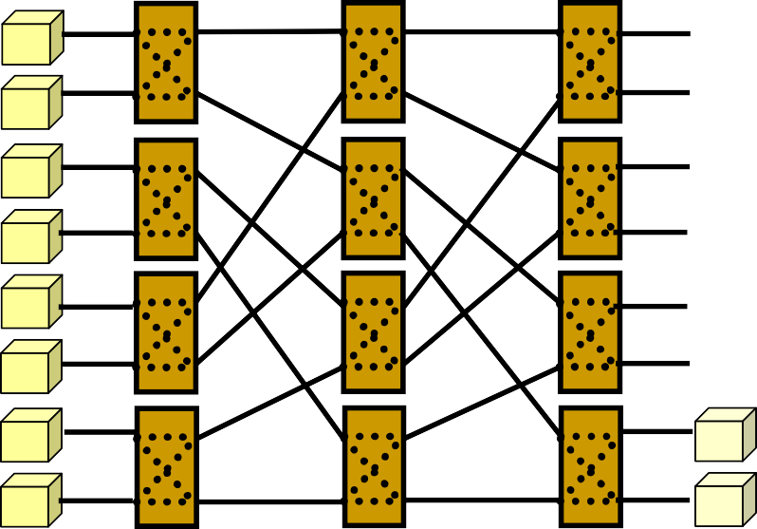













Indirect Interconnects
Shared bus
Multiple bus
2x2 crossbar
Crossbar switch
Multistage Interconnection Network

Slide 15
Direct Interconnect Topologies
Star
Ring
Linear
2D
Mesh
Hypercube (binary n-cube)
n=2 n=3
Torus

Slide 16
Shared Memory Architecture: Caches
P1
Read X Write X=1
P2
Read X
X: 0
X: 1
Cache hit: Wrong data!!
X: 0
X: 0
X: 1

Slide 17
Cache Coherence Problem
If each processor in a shared memory multiple processor machine has a data cache
  Potential data consistency problem: the cache coherence problem
  Shared variable modification, private cache
Objective: processes shouldn’t read `stale’ data
Solutions
  Hardware: cache coherence mechanisms
  Software: compiler assisted cache coherence

Slide 18
Example: Write Once Protocol
Assumption: shared bus interconnect where all cache controllers monitor all bus activity
  Called snooping
There is only one operation through bus at a time; cache controllers can be built to take corrective action and enforce coherence in caches
  Corrective action could involve updating or invalidating a cache block

Slide 19
Example: Write Once Protocol.
P1
Write X=1
P2
Read X: Cache Miss
Read X
X: 0
X: 1
X: 0
X: 0
X: 1

